Slide 1

NEW
This September, we’re kicking off the ADRA Appeal with a race around Australia - a distance challenge for all fitness levels.
Walk or run as many kilometres as you can, rally support, and help raise vital funds for Aussies doing it tough. Together, we can provide food, essential items, and connection for those who need it most.
Sign up now and start making a difference.
Register at race.adra.org.au

Slide 2

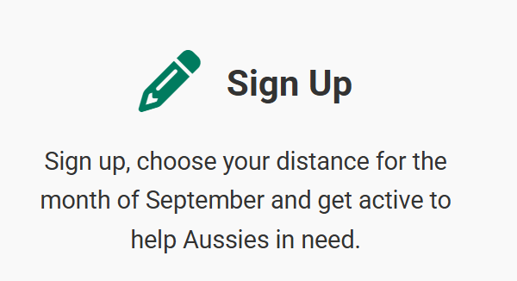
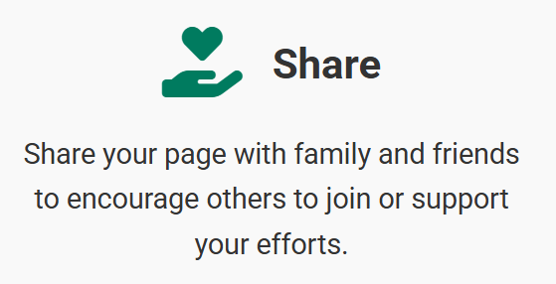
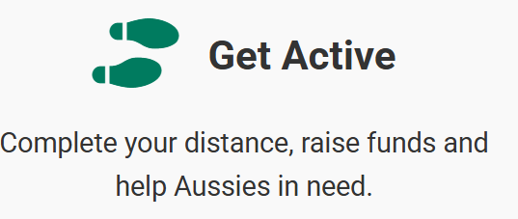
How can I participate?
You can register as an individual or a team

Slide 3

How can I support
My Friends?
Search for their name at:
race.adra.org.au
More Questions?
race.adra.org.au/faqs
race.adra.org.au/resources

